Slide 1
Critical Thinking and Action Mazes Jamie Bailey

Slide 2
What is critical thinking?
Critical Thinking is the deliberate process of questioning, evaluating, and responding to problems, scenarios, and arguments in order to reach sound solutions, decisions, and positions. To begin to think outside the box.

Slide 4
What makes a critical thinker?
Ask pertinent questions that clarify and focus a problem, scenario, or argument
Evaluate the quantity, quality, and usefulness of information;
Articulate a sound solution, decision, or position based on appropriate standards of reasoning; and
Monitor and reflect upon the quality and fairness of their reasoning.

Slide 5
Let’s Review:
Which of the following is not a quality of a critical thinker?
A) Asking pertinent questions
B) Monitor and reflect upon their reasoning
C) Going with the majority

Slide 6
Let’s Review:
Which of the following is not a quality of a critical thinker?
A) Asking pertinent questions
B) Monitor and reflect upon their reasoning
C) Going with the majority

Slide 7
Let’s Review:
Which of the following is not a quality of a critical thinker?
A) Asking pertinent questions
B) Monitor and reflect upon their reasoning
C) Going with the majority

Slide 8
Let’s Review:
Which of the following is not a quality of a critical thinker?
A) Asking pertinent questions
B) Monitor and reflect upon their reasoning
C) Going with the majority

Slide 9
So how do we promote critical thinking?
Action Mazes

Slide 10
So what is an action maze?
Similar to the Choose Your Own Adventure book series. One will be presented with a series of situations; in each situation you will need to make a decision on the best way to proceed. Each decision you make will take you to the next part of the maze. If you make all the right decisions, you will be able to complete the maze successfully. Here is a sample maze!

Slide 11
In other words…
What should you do?
Option A
Option B
Option BA
Option AB
Option AA
Option BB
And so on, each option leads you to a new set of decisions until you have been able to exhaust all options.

Slide 12
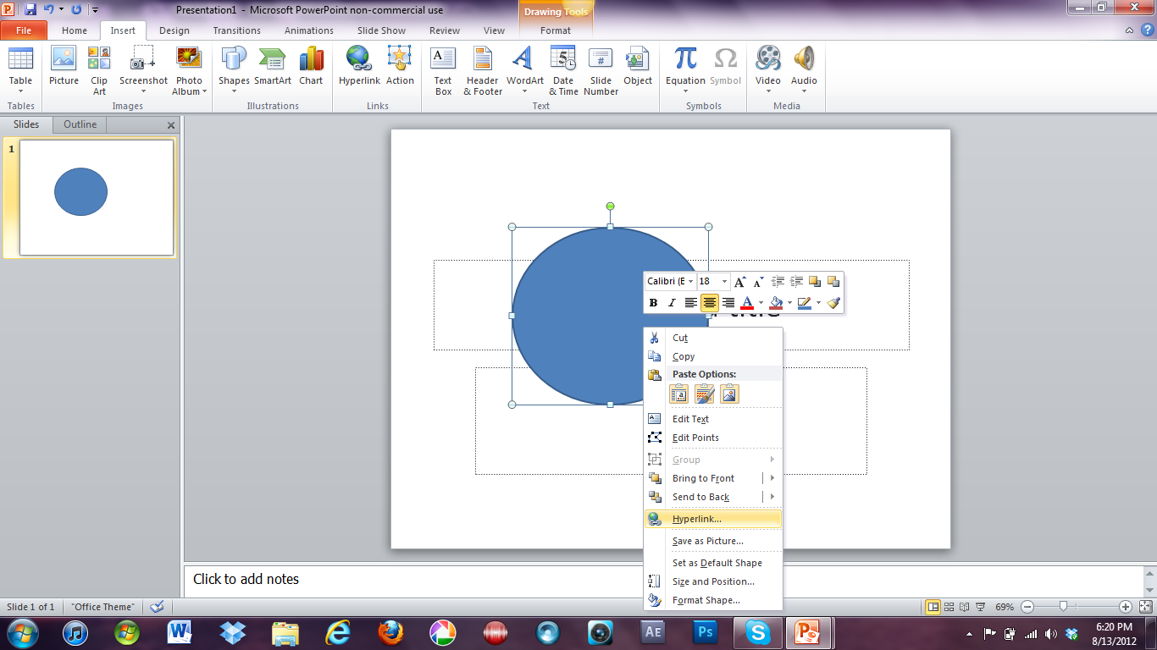
Create an Action Maze in PPT
Action Mazes don’t have to be online only, you can create them in PowerPoint for students to do. It is just like making a normal presentation, you just hyperlink all the slides together. To do this, you select the item to hyperlink, right-click and select hyperlink.

Slide 13
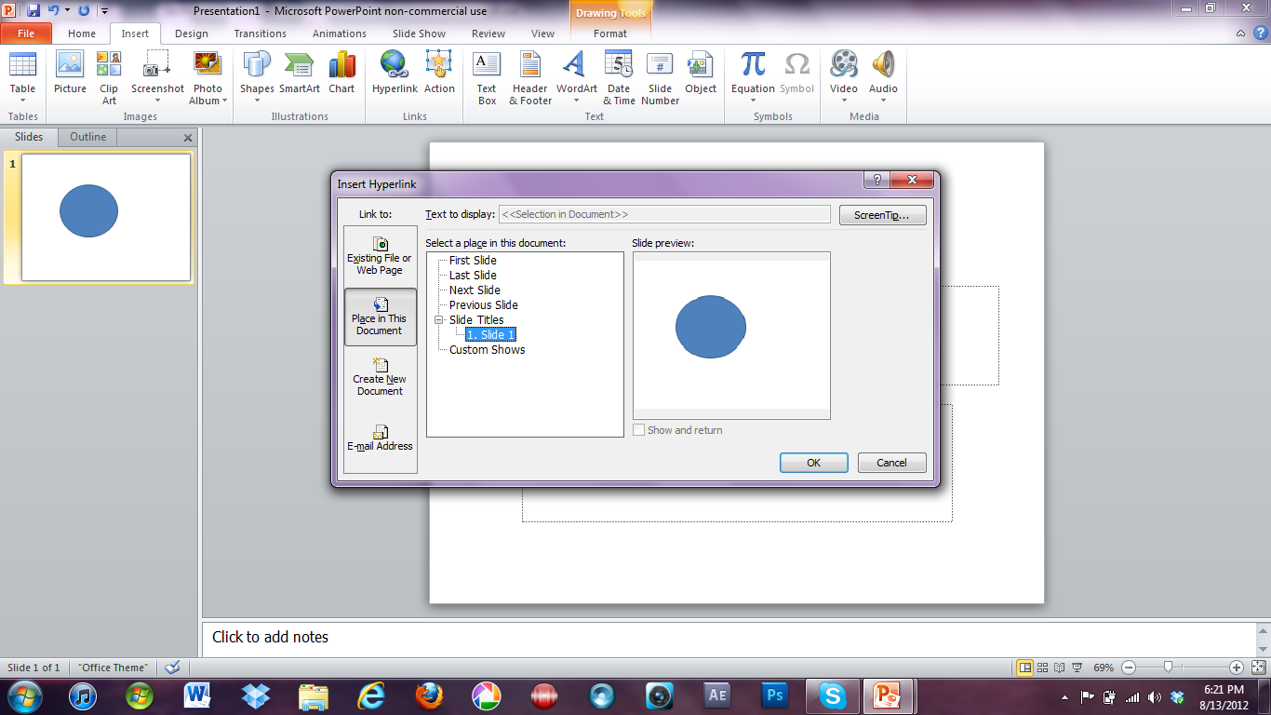
Create an Action Maze in PPT
Once selected, you simply select which slide you wish to link.
Just repeat this process until all the slides are linked together.

Slide 14
Review Quiz #1
An Action Maze is similar to…
A) American Girl Series
B) Choose Your Own Adventures
C) Goosebumps

Slide 15
Review Quiz #1
An Action Maze is similar to…
A) American Girl Series
B) Choose Your Own Adventures
C) Goosebumps

Slide 16
Review Quiz #1
An Action Maze is similar to…
A) American Girl Series
B) Choose Your Own Adventures
C) Goosebumps

Slide 17
Review Quiz #1
An Action Maze is similar to…
A) American Girl Series
B) Choose Your Own Adventures
C) Goosebumps

Slide 18
Review Quiz #2
Which of the following is part of the critical thinking process?
A) Evaluating
B) Exploring
C) Thinking inside the box

Slide 19
Review Quiz #2
Which of the following is part of the critical thinking process?
A) Evaluating
B) Exploring
C) Thinking inside the box

Slide 20
Review Quiz #2
Which of the following is part of the critical thinking process?
A) Evaluating
B) Exploring
C) Thinking inside the box

Slide 21
Review Quiz #2
Which of the following is part of the critical thinking process?
A) Evaluating
B) Exploring
C) Thinking inside the box

Slide 22
Review Quiz #3
Other than online, how can you create a Action Maze?
A) Microsoft Word
B) Microsoft Excel
C) Microsoft PowerPoint

Slide 23
Review Quiz #3
Other than online, how can you create a Action Maze?
A) Microsoft Word
B) Microsoft Excel
C) Microsoft PowerPoint

Slide 24
Review Quiz #3
Other than online, how can you create a Action Maze?
A) Microsoft Word
B) Microsoft Excel
C) Microsoft PowerPoint

Slide 25
Review Quiz #3
Other than online, how can you create a Action Maze?
A) Microsoft Word
B) Microsoft Excel
C) Microsoft PowerPoint

Slide 26
Review Quiz #4
When creating an Action Maze in PowerPoint, it is important to remember to ________________ all aspects of the slide together.
A) Hyperlink
B) Do nothing
C) Save

Slide 27
Review Quiz #4
When creating an Action Maze in PowerPoint, it is important to remember to ________________ all aspects of the slide together.
A) Hyperlink
B) Do nothing
C) Save

Slide 28
Review Quiz #4
When creating an Action Maze in PowerPoint, it is important to remember to ________________ all aspects of the slide together.
A) Hyperlink
B) Do nothing
C) Save

Slide 29
Review Quiz #4
When creating an Action Maze in PowerPoint, it is important to remember to ________________ all aspects of the slide together.
A) Hyperlink
B) Do nothing
C) Save

Slide 30
You are ready to go now!
Start Over

